Slide 1

Horizon
Patient centered information exchange system

Slide 2
01
02
TABLE OF CONTENTS
03
04
INTRODUCTION
Inspiration
Authorization
Technology Used

Slide 3

Horizon
Horizon is a patient centred information exchange system that allows patients to upload their medical documents so that they can be accessed online.
It allows the respective doctors to write online prescriptions and upload the latest test reports online.
No one is allowed to access and edit the details until unless the doctor and the respective patient are connected.

Slide 4
Inspiration
The inspiration came from the various people like :
People who were travelling so long for just collecting their lab reports.
People who were worried about their lost prescriptions,
People who were not aware of the availability time of the doctors,
People who use to forget to keep their documents with them in a hurry.
Last but not the least, crowded hospitals became the major inspiration during COVID-19.

Slide 5
Patient Side
Add / Edit Personal Details
Add Lab Reports
Patient can add and edit their personal details like name, phone number, age etc.
Patient can add there respective lab reports so that they can access them later from anywhere
Add Prescription
Check Doctor Profile
Patient can add prescription just by clicking image and adding basic details like doctor name, department, date etc
Patient can check doctor’s profile to know about doctors contact, fees, timing, department etc.

Slide 6
Doctor’s Side
Add / Edit Personal Details
Check Patient Profile
Doctor can add and edit their personal details like name, phone number,fees etc.
Doctor can check patient’s profile to contact them and send request as well.
Prescription / E-Prescription
Lab Reports
Doctor can add and view prescription or E prescription to the patient’s profile only after patient accepts the connection request.
Doctor can add and view patient’s lab reports only after connecting to patient.

Slide 7
Authorization
 | Patient’s Profile | Doctor’s Profile | Lab Reports | Prescription | E-Prescription
Patient
Doctor before connecting
Doctor after connecting

Slide 8
Upcoming Goals
01
02
03
04
Add chatbot
Appointment
Reminder
Order Medication
Chatbot which will allow the patient to share the symptoms and it will revert back with the possible diseases.
Patient can take future appointment of the doctor
Mail reminding patient that they have and appointment in upcoming days
Can order medicines that prescribe for long time, 2 days before they end

Slide 9




Technologies Used
Ejs

Slide 10
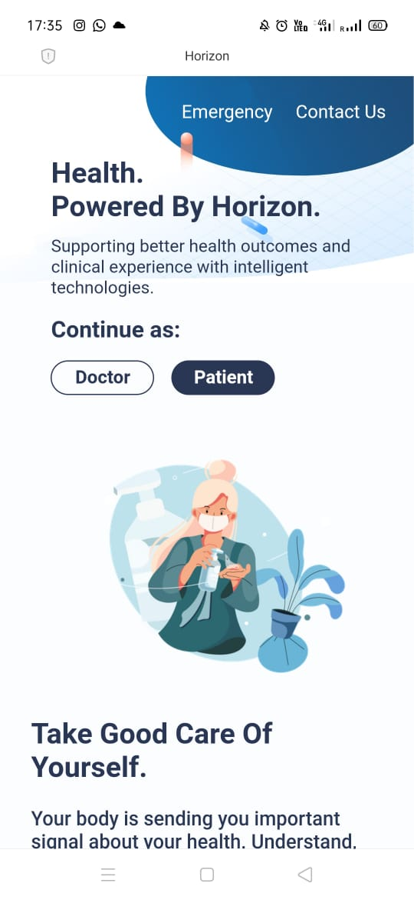
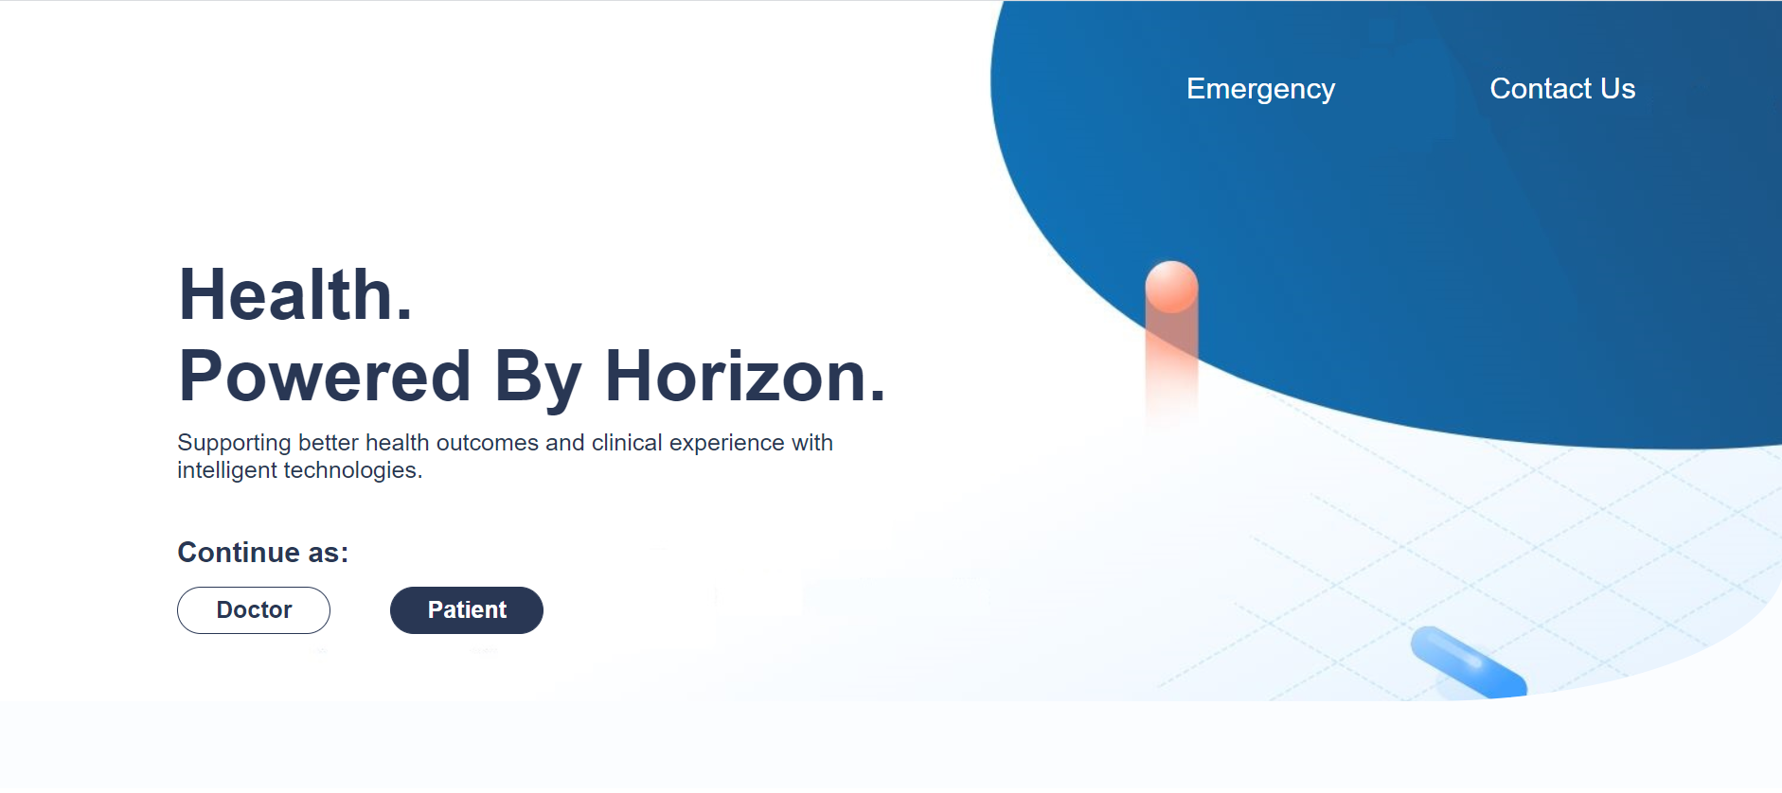
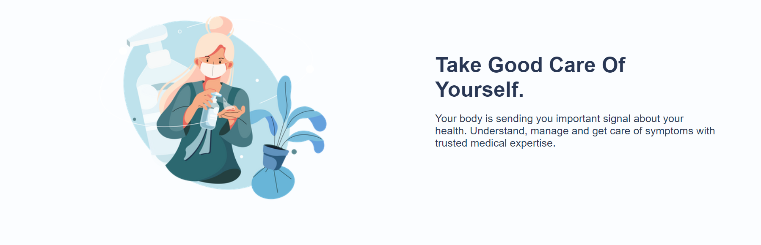
Landing Page

Slide 11
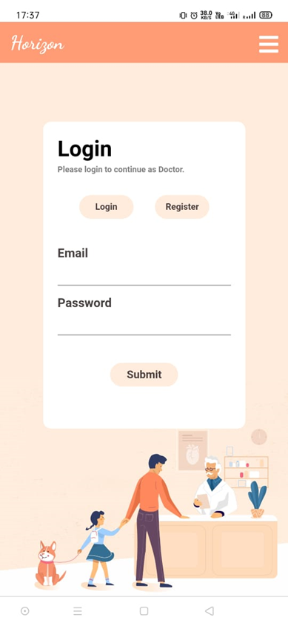
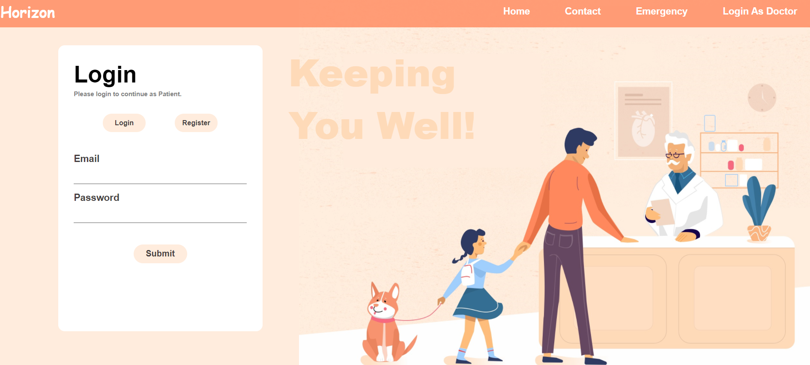
Login Page

Slide 12
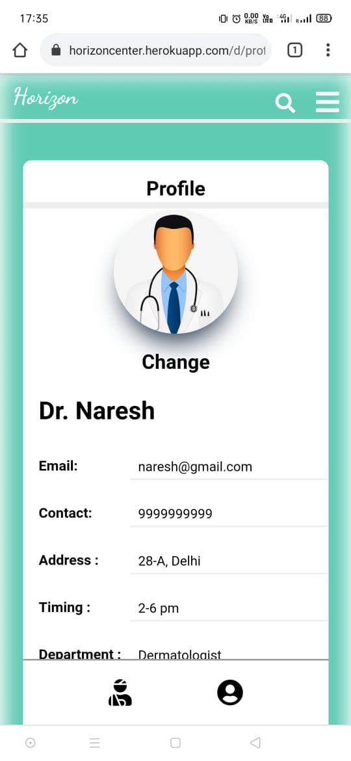
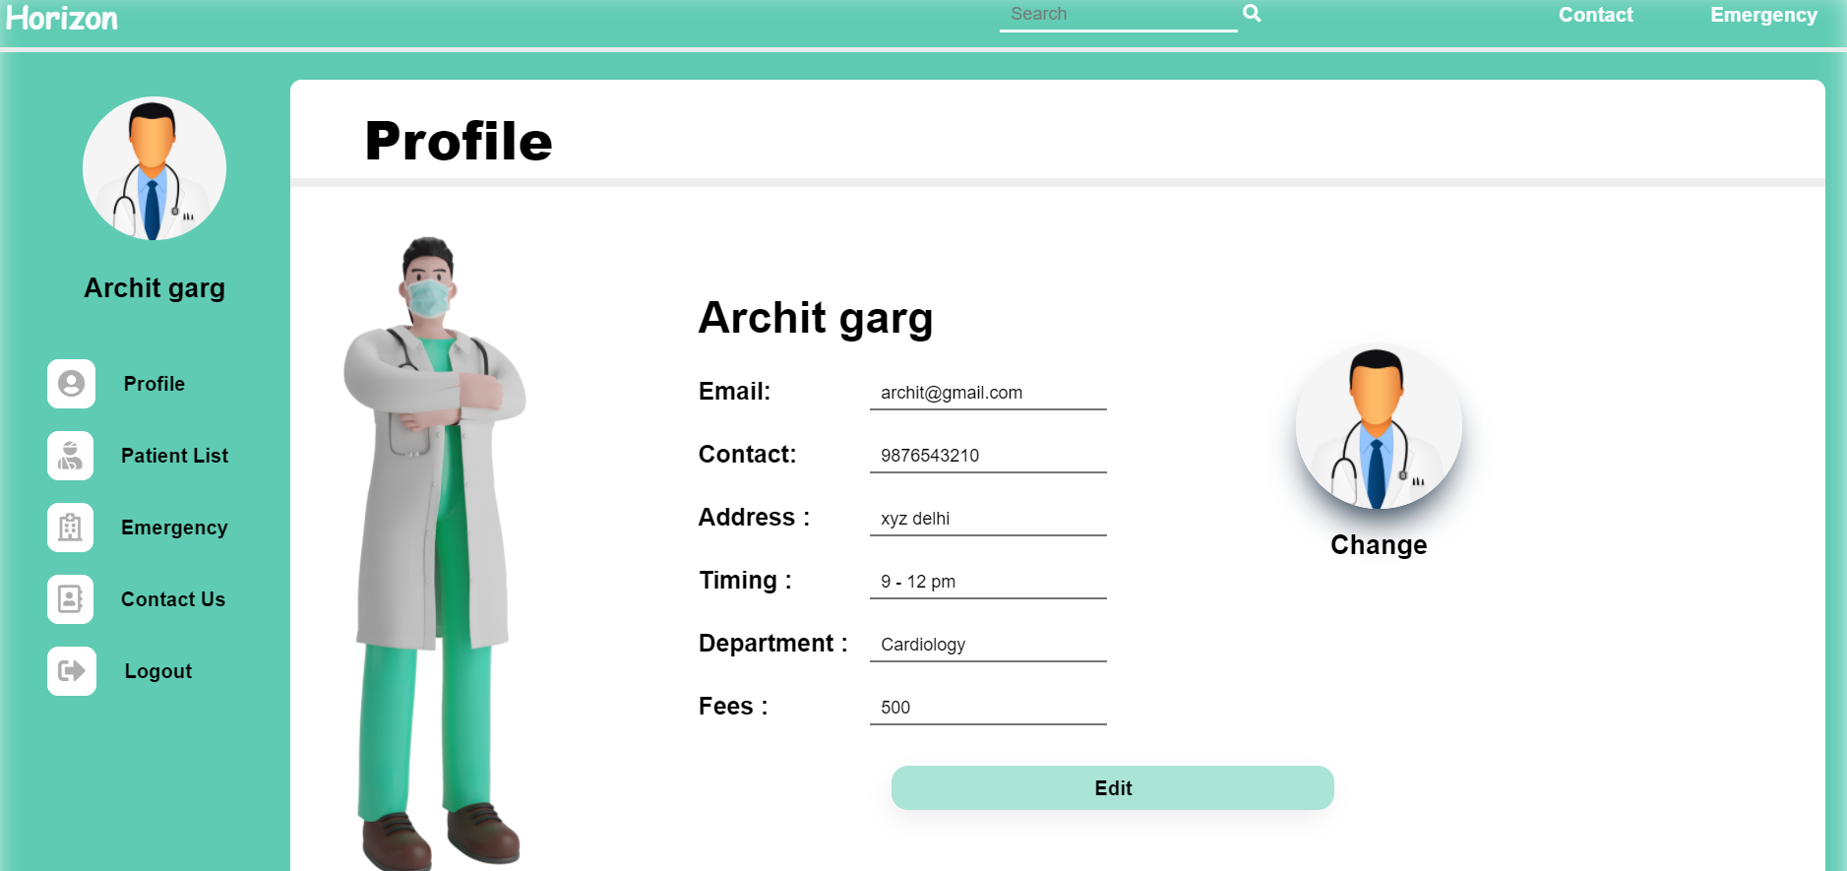
Doctor’s Profile

Slide 13
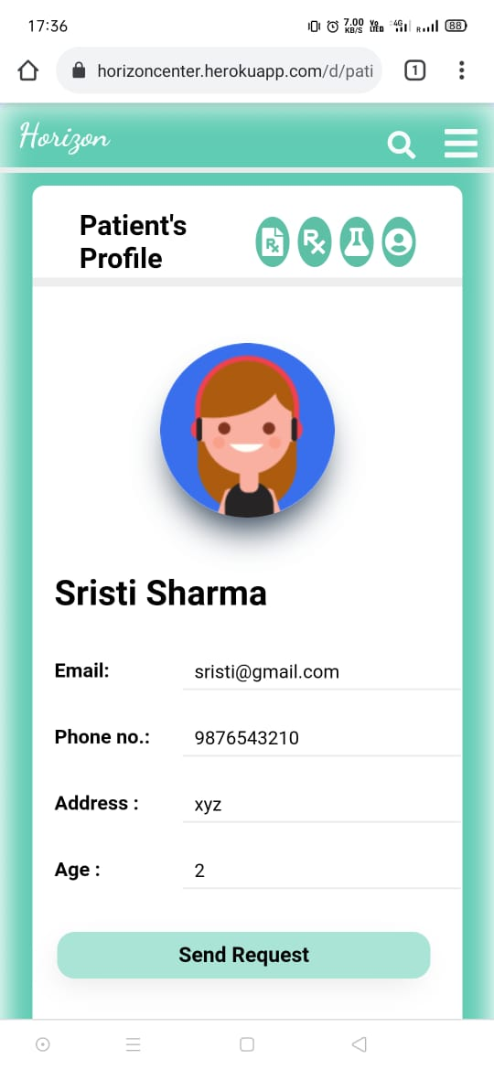
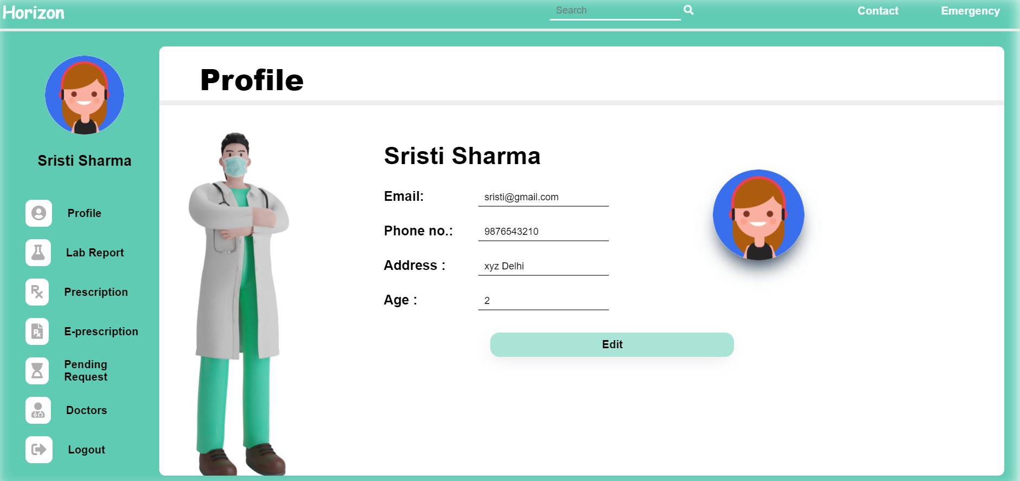
Patient’s Profile

Slide 14
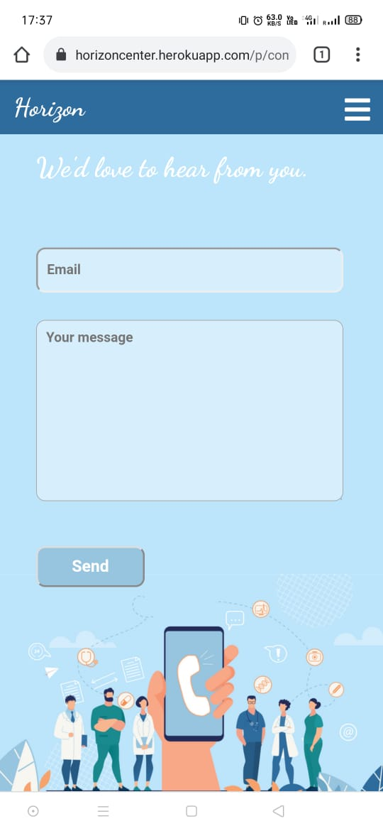
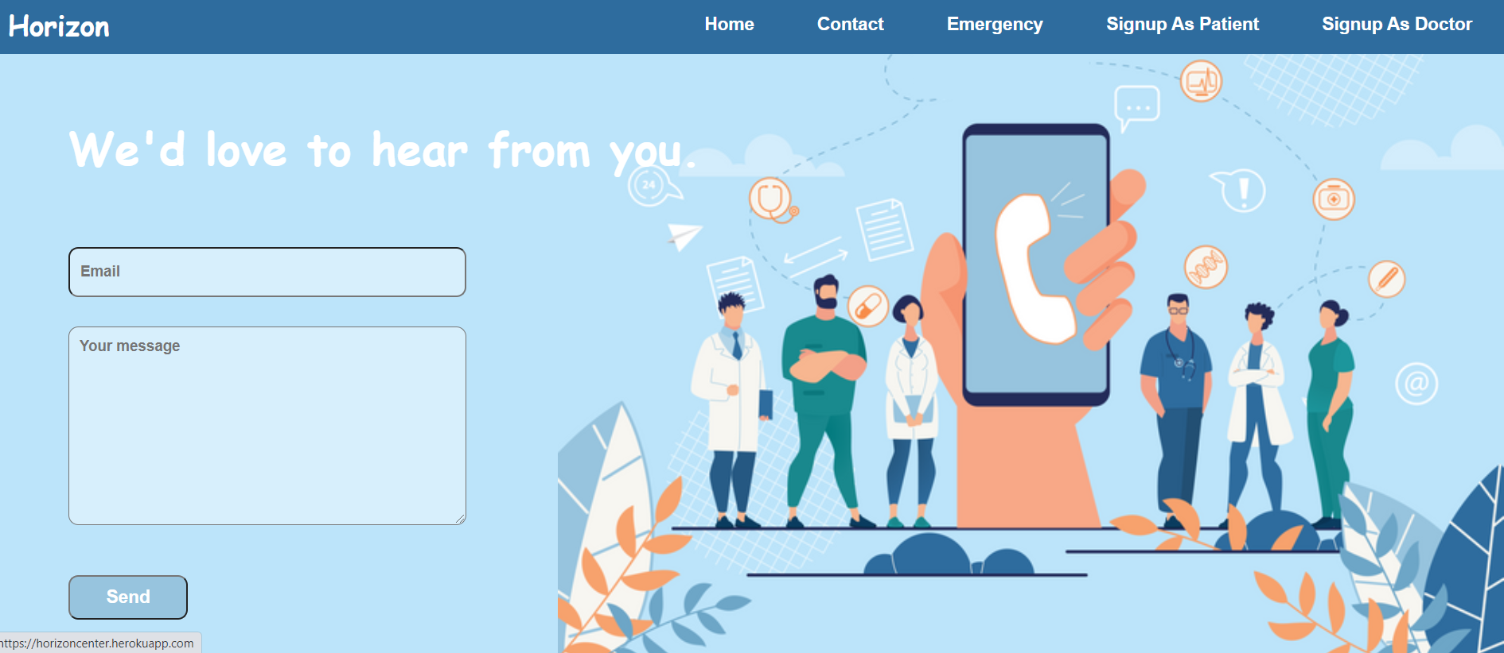
Contact Us

Slide 15
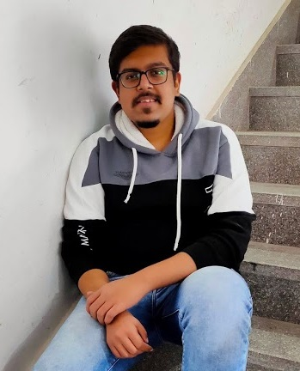


Team TechByte
Archit Garg
Tiksha Varshney
Palak Ahuja
LinkedIn
LinkedIn
LinkedIn

Slide 16


Thanks!
Do you have any questions?
GITHUB https://github.com/architgarg603/Horizon
WEBSITE https://horizoncenter.herokuapp.com/

